Slide 1


Dependency Injection
Ivan Lazarević

Slide 2


What is DI?
Wikipedia
Dependency injection is a software design pattern that allows a choice of component to be made at run-time rather than compile time.
2012
Dependency injection is a software design pattern that allows the removal of hard-coded dependencies and makes it possible to change them, whether at run-time or compile-time.
2013
In software engineering, dependency injection is a technique whereby one object supplies the dependencies of another object.
2017

Slide 3
What is DI?
Dependency Injection is a set of software design principles and patterns that enable us to develop loosely coupled code.
Mark Seemann. Dependency Injection in .NET.Manning, 2012.

Slide 4
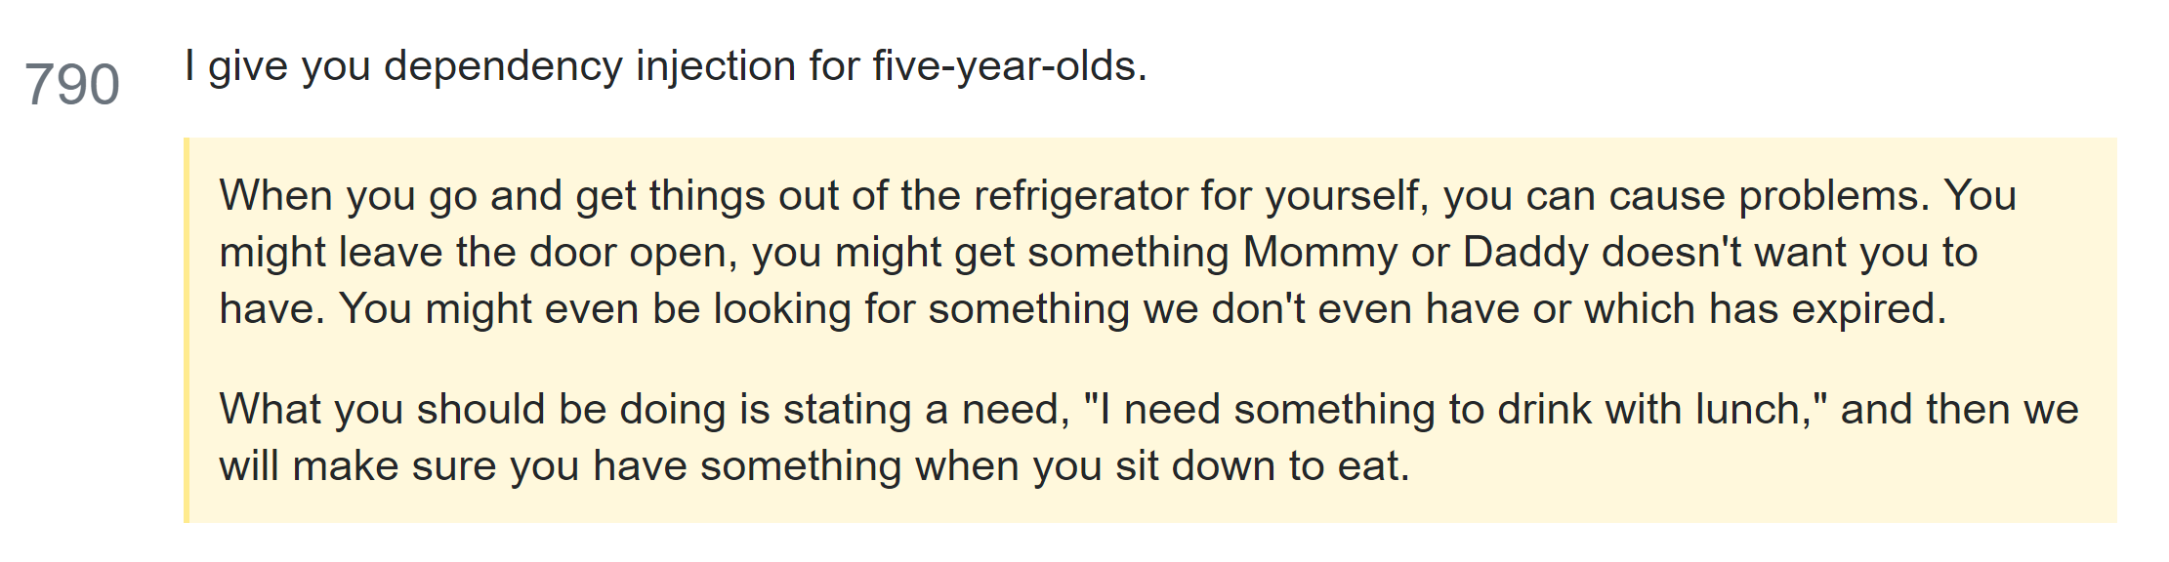
What is DI?
☺ How to explain dependency injection to a 5-year-old?
http://stackoverflow.com/questions/1638919/how-to-explain-dependency-injection-to-a-5-year-old

Slide 5
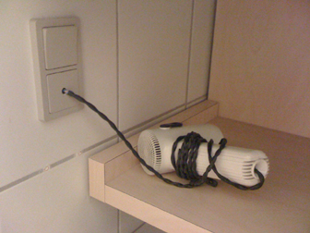



Understanding the purpose of DI
LISKOV SUBSTITUTION
PRINCIPLE
Cheap hotel
Adapter

Slide 6

Understanding the purpose of DI
LISKOV SUBSTITUTION
PRINCIPLE
Cheap hotel
Decorator Pattern
UPS

Slide 7
DEMO: Hello DI - simple console app example

Slide 8
Application Layering
We have layers, so we have loose coupling.
View
Presentation
Repository
Let’s look at the code!
Service

Slide 9

Tight Coupling
View
Presentation
Repository
Service

Slide 10
Lab example: Tight Coupling to Loose Coupling

Slide 11
Benefits of DI
Benefit | Description | When is it valuable?
Late binding | Services can be swapped with other services. | Valuable in standard software, but perhaps less so in enterprise applications where the runtime environment tends to be well-defined
Extensibility | Code can be extended and reused in ways not explicitly planned for. | Always valuable
Parallel development | Code can be developed in parallel. | Valuable in large, complex applications; not so much in small, simple applications
Maintainability | Classes with clearly defined responsibilities are easier to maintain. | Always valuable
TESTABILITY | Classes can be unit tested. | Only valuable if you unit test

Slide 12
XY

Slide 13
Thank you for your attention

